Slide 1
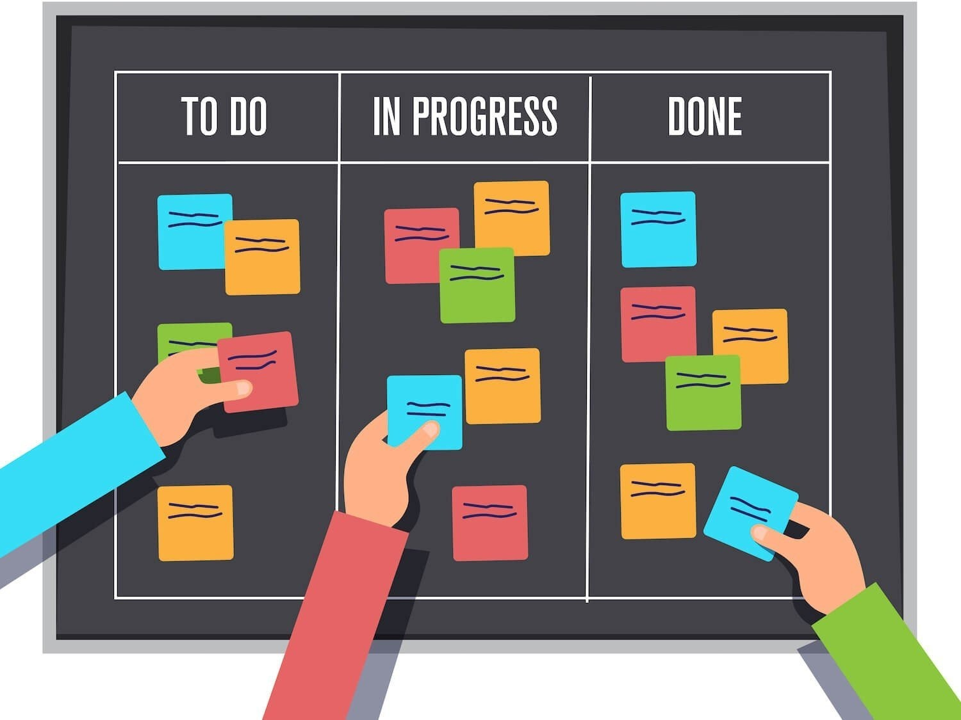
SIMPLE TASK TRACKER POC
THE GOLDEN HACKERS
MEGHA.P.H MAMATA.P INDU.P
APOORVA.A.T MANOHARI.A
KUB23CSE082 KUB23CSE075
KUB23CSE043 KUB23CSE012 KUB23CSE078

Slide 2
SHORT DESCRIPTION :
Simple Task Tracker POC:
Easy Task Management: Create, update, and delete tasks with simplicity.
Status Tracking: Monitor task progress (To-Do, In Progress, Done).
Priority and Due Date: Assign priority and due dates for timely completion.
Intuitive Interface: User-friendly design for enhanced productivity.
Collaboration Ready: Built for individuals and small teams to streamline tasks.

Slide 3
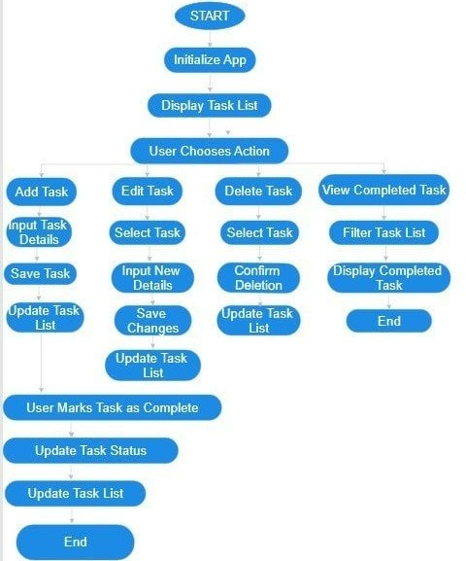
Algorithm:

Slide 4
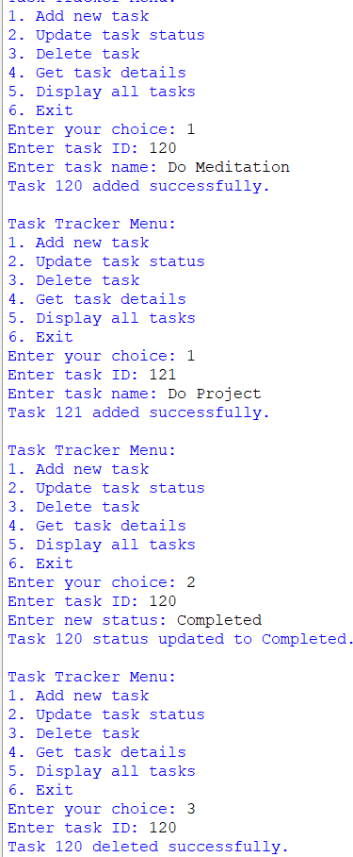
OUTPUT:

Slide 5
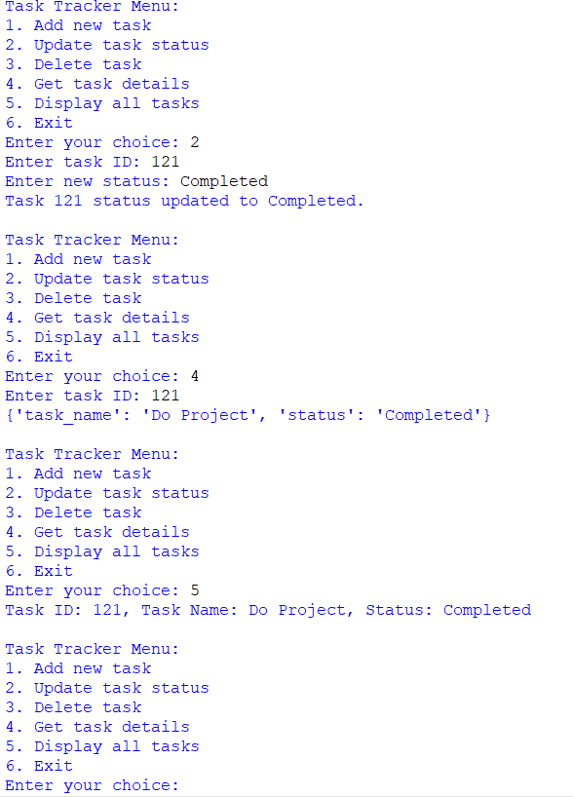

Slide 6
FUTURE ENHANCEMENTS:
1.AI-powered Task Prioritization: The future of task management lies in leveraging AI to predict task priorities and organize to-do lists for maximum efficiency . This feature could be integrated into the Simple Task Tracker POC to make it more intelligent and user-friendly. 2.Task Automation: Automating repetitive tasks can save users a significant amount of time and effort. The Simple Task Tracker POC could be enhanced to allow users to automate tasks based on specific triggers or conditions. 3.Collaborative Task Management: The Simple Task Tracker POC could be expanded to include features that enable seamless collaboration and communication among team members. This could include real-time commenting, @mentions, and task assignment. 4.Integrations with Other Tools: Integrating the Simple Task Tracker POC with other popular productivity tools, such as calendar apps or project management software, could enhance its functionality and appeal to a wider user base.

Slide 7


Slide 8


